Slide 1
Fundamentals of Artifical Intelligence
Week 3

Slide 2
What are we going to do today?
Agents Recap
Simple Reflex Agents
Model-Based Reflex Agents
Goal-Based Agents
Utility-Based Agents
Learning Agent
Finite State Machines (FSMs)
What are Finite State Machines?
How to FSMs link to AI?
Finite State Diagrams
Finite State Transition Table
Coding

Slide 3
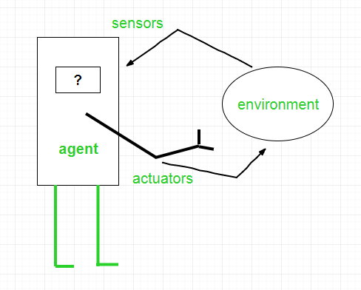
Agents in Artificial Intelligence
Artificial intelligence is defined as the study of rational agents. A rational agent could be anything that makes decisions, as a person, firm, machine, or software. It carries out an action with the best outcome after considering past and current percepts(agent’s perceptual inputs at a given instance). An AI system is composed of an agent and its environment. The agents act in their environment. The environment may contain other agents.
An agent is anything that can be viewed as :
perceiving its environment through sensors and
acting upon that environment through actuators
Note: Every agent can perceive its own actions (but not always the effects)

Slide 4
Examples of Agent:
To understand the structure of Intelligent Agents, we should be familiar with Architecture and Agent programs. Architecture is the machinery that the agent executes on. It is a device with sensors and actuators, for example, a robotic car, a camera, a PC. Agent program is an implementation of an agent function. An agent function is a map from the percept sequence(history of all that an agent has perceived to date) to an action.
Agent = Architecture + Agent Program

Slide 5
Types of Agents
Agents can be grouped into five classes based on their degree of perceived intelligence and capability :
Simple Reflex Agents
Model-Based Reflex Agents
Goal-Based Agents
Utility-Based Agents
Learning Agent

Slide 6
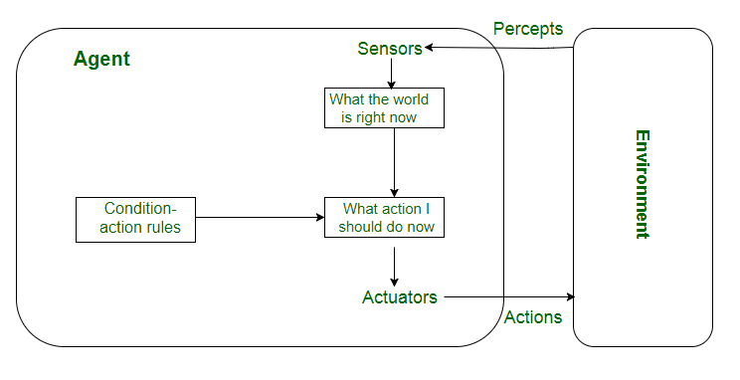
Simple reflex agents
Simple reflex agents ignore the rest of the percept history and act only on the basis of the current percept. Percept history is the history of all that an agent has perceived to date. The agent function is based on the condition-action rule. A condition-action rule is a rule that maps a state i.e, condition to an action. If the condition is true, then the action is taken, else not. This agent function only succeeds when the environment is fully observable. For simple reflex agents operating in partially observable environments, infinite loops are often unavoidable. It may be possible to escape from infinite loops if the agent can randomize its actions.
Problems with Simple reflex agents are :
Very limited intelligence.
No knowledge of non-perceptual parts of the state.
Usually too big to generate and store.
If there occurs any change in the environment, then the collection of rules need to be updated.

Slide 7
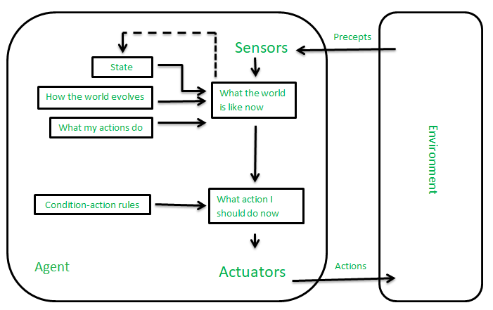
Model-based reflex agents
It works by finding a rule whose condition matches the current situation. A model-based agent can handle partially observable environments by the use of a model about the world. The agent has to keep track of the internal state which is adjusted by each percept and that depends on the percept history. The current state is stored inside the agent which maintains some kind of structure describing the part of the world which cannot be seen.
Updating the state requires information about :
how the world evolves independently from the agent, and
how the agent’s actions affect the world.

Slide 8
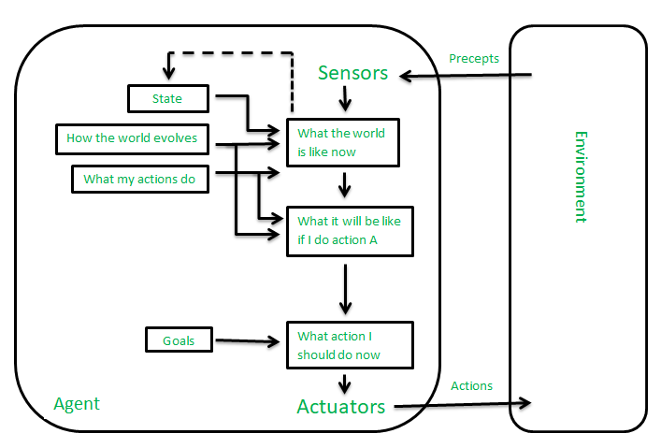
Goal-based agents
These kinds of agents take decisions based on how far they are currently from their goal(description of desirable situations). Their every action is intended to reduce its distance from the goal. This allows the agent a way to choose among multiple possibilities, selecting the one which reaches a goal state. The knowledge that supports its decisions is represented explicitly and can be modified, which makes these agents more flexible. They usually require search and planning. The goal-based agent’s behavior can easily be changed.

Slide 9
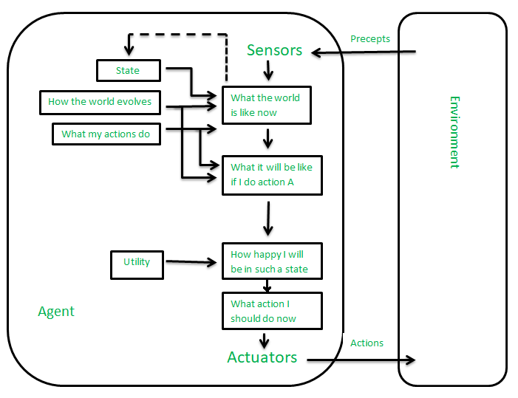
Utility-based agents
The agents which are developed having their end uses as building blocks are called utility-based agents. When there are multiple possible alternatives, then to decide which one is best, utility-based agents are used. They choose actions based on a preference (utility) for each state. Sometimes achieving the desired goal is not enough. We may look for a quicker, safer, cheaper trip to reach a destination. Agent happiness should be taken into consideration. Utility describes how “happy” the agent is. Because of the uncertainty in the world, a utility agent chooses the action that maximizes the expected utility. A utility function maps a state onto a real number which describes the associated degree of happiness.

Slide 10
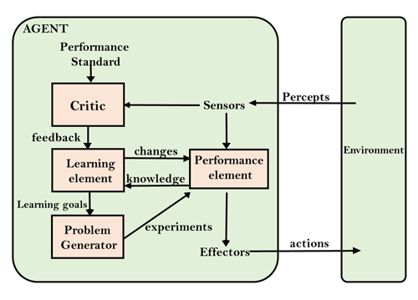
Learning Agent :
A learning agent in AI is the type of agent that can learn from its past experiences or it has learning capabilities. It starts to act with basic knowledge and then is able to act and adapt automatically through learning. A learning agent has mainly four conceptual components, which are:
Learning element: It is responsible for making improvements by learning from the environment
Critic: The learning element takes feedback from critics which describes how well the agent is doing with respect to a fixed performance standard.
Performance element: It is responsible for selecting external action
Problem Generator: This component is responsible for suggesting actions that will lead to new and informative experiences.

Slide 11
Finite State Machines (FSMs)
FSM’s also known as Finite State Automata or Transition Networks
A finite state machine (FSM) is a mathematical model of computation that defines an abstract machine which can be in exactly one of a finite number of states at any given time. It transitions from one state to another in response to inputs.
Used to design h/w and s/w, especially complex interactions Describes a system which exists in a series of states AI behaviour described by transitions between states in s/w

Slide 12
Finite State Machines (FSMs)
So we can see that Finite State Machines allow us to model the way something works from INITIAL STATE through all other STATES.
Take as an example a light. A traditional light can exist in 2 states, ON and OFF. Now depending on which state a light is in determines what happens when we press the light switch.
ON ->Press-> OFF
OFF ->Press-> ON

Slide 13
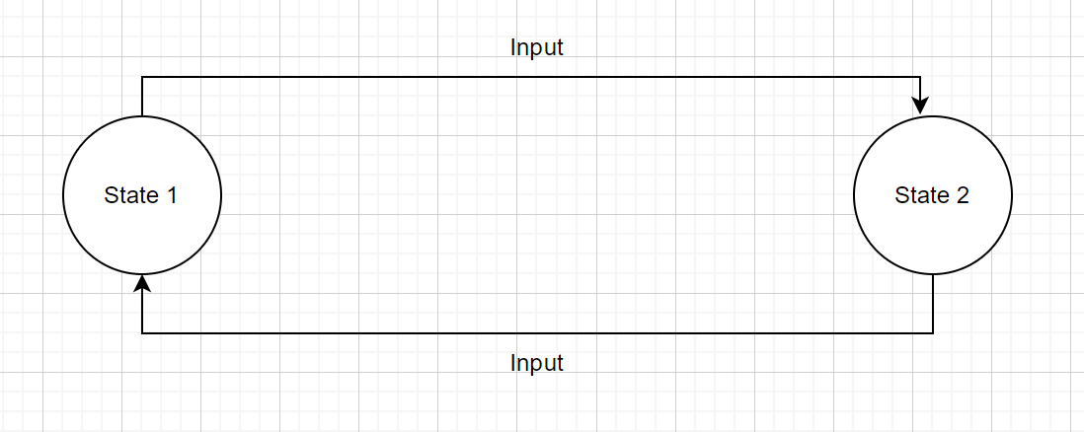
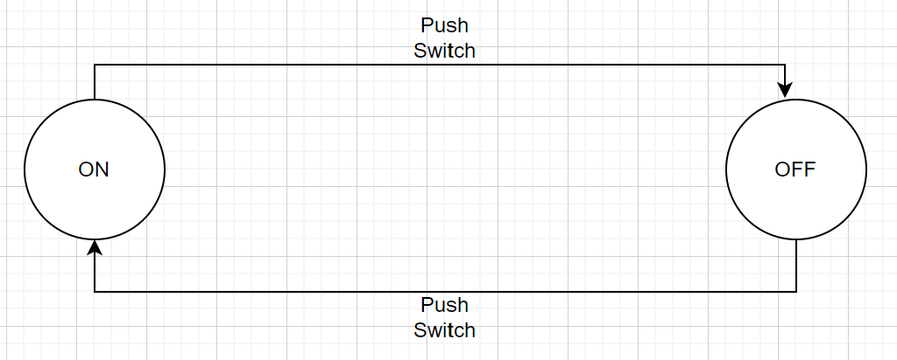
Finite State Machines (FSMs)
So how do we depict this as a diagram? The diagram below has 3 things, states, labels and arrows as you can see, this is a very basic example of a finite state machine

Slide 14
Finite State Machines (FSMs)
Current State | Input | Next State | Output
OFF | Push Switch | ON
ON | Push Switch | OFF

Slide 15
Finite State Machines (FSMs)
using System;
using System.Collections.Generic;
using System.Linq;
using System.Text;
using System.Threading.Tasks;
namespace ConsoleApp3
{
enum States
{
Off,
On
}
class Program
{
static States currentState = States.Off;
static void Main(string[] args)
{
while (true)
{
switch (currentState)
{
case States.Off:
Console.WriteLine("The light is off.");
Console.WriteLine("Press 'T' to turn on.");
if (Console.ReadKey().Key == ConsoleKey.T)
{
currentState = States.On;
}
break;
case States.On:
Console.WriteLine("The light is on.");
Console.WriteLine("Press 'T' to turn off.");
if (Console.ReadKey().Key == ConsoleKey.T)
{
currentState = States.Off;
}
break;
}
}
}
}
}

Slide 16
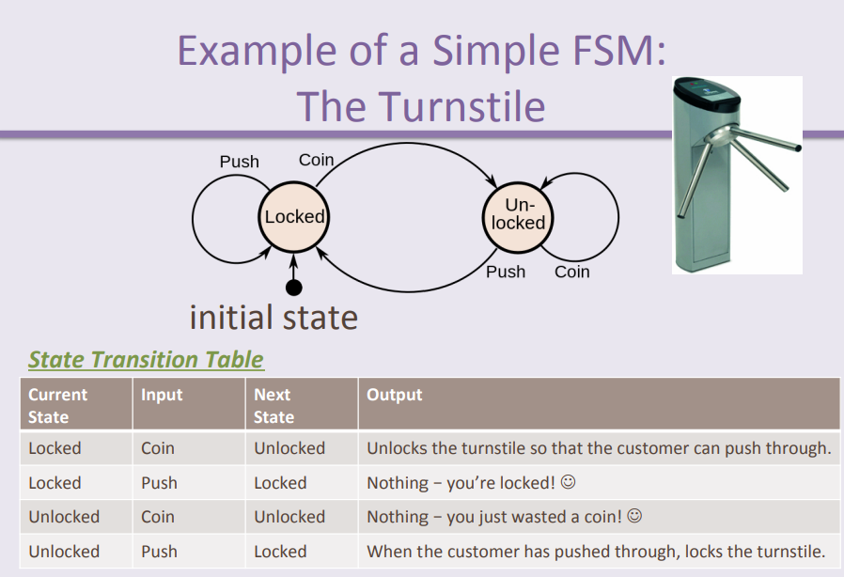
Another example

Slide 17
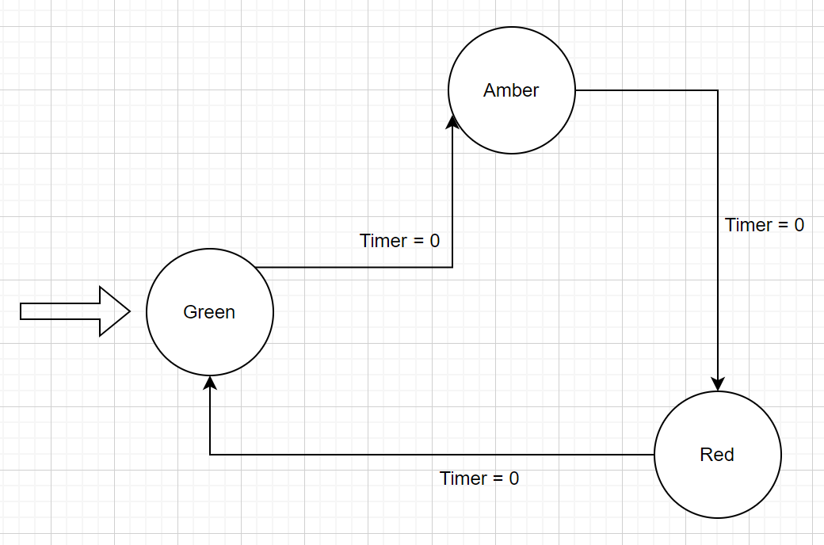
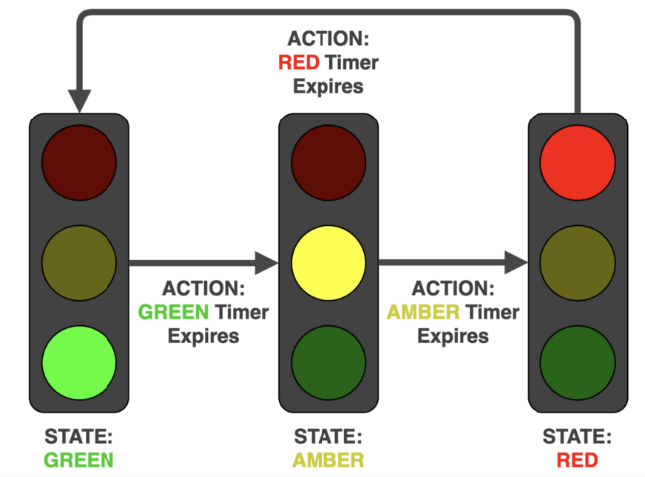
Traffic Lights
Current State | Input | Next State | Output

Slide 18
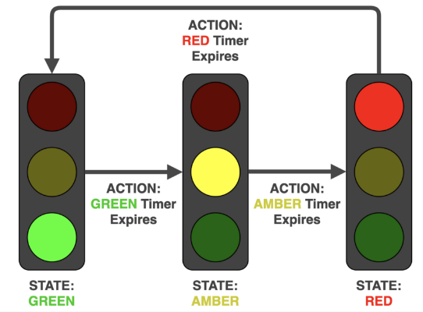
Exercise – Add a pedestrian crossing to the solution
Current State | Input | Next State | Output

Slide 19
using System;
using System.Collections.Generic;
using System.Linq;
using System.Text;
using System.Threading.Tasks;
namespace ConsoleApp3
{
enum States
{
Red,
Green,
Yellow
}
class Program
{
static States currentState = States.Red;
static void Main(string[] args)
{
while (true)
{
switch (currentState)
{
case States.Red:
Console.WriteLine("Red light is on.");
Console.WriteLine("Wait for green light.");
System.Threading.Thread.Sleep(5000);
currentState = States.Green;
break;
case States.Green:
Console.WriteLine("Green light is on.");
Console.WriteLine("Wait for yellow light.");
System.Threading.Thread.Sleep(3000);
currentState = States.Yellow;
break;
case States.Yellow:
Console.WriteLine("Yellow light is on.");
Console.WriteLine("Wait for red light.");
System.Threading.Thread.Sleep(2000);
currentState = States.Red;
break;
}
}
}
}
}

Slide 20
Exercise
Consider our Maze solving algorithm from last week and modelling an AI approach to this user State Transition Diagrams and Tables.
Start with the following maze, test your theory with the maze on the right.

Slide 21
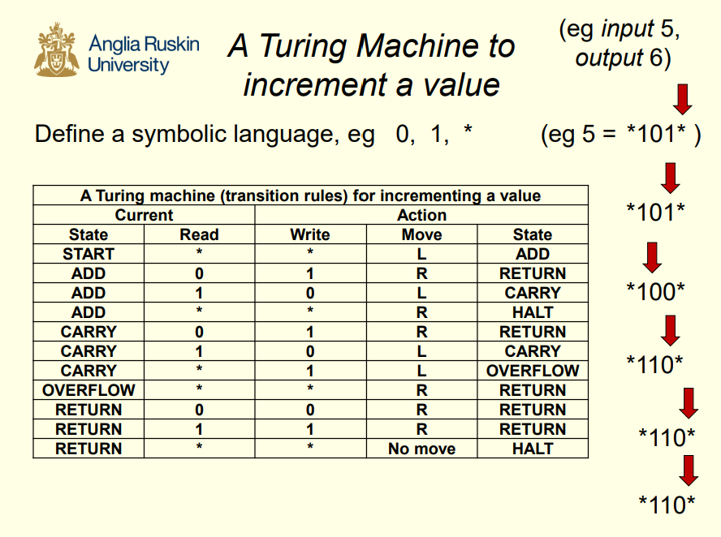
Portfolio Exercise – Turing Machine

Slide 22
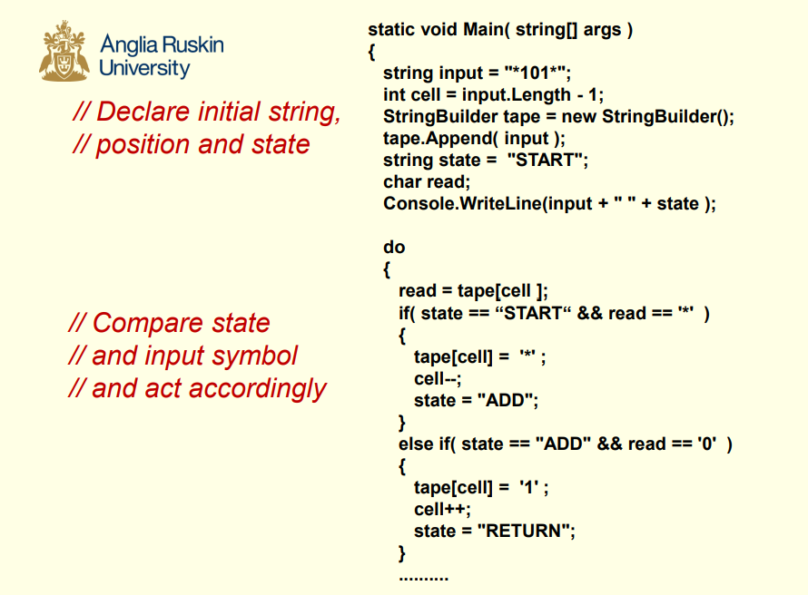
Portfolio Exercise – Turing Machine

